Slide 1
Project Description
The objective of this project is to perform data analysis on the data collected with the mobile App YoUnicam.
The analysis must consider the information available from the APP dataset to train a machine learning model to be used for feedback to the final users. For example, student can implement one of the two features:
Estimate the number of people expected in a department given an input day time
Estimate the number of reservations expected in library given an input day time

Slide 2
Implementation Step
Clean Dataset (fill or delete the useless or NULL data)
Transform to the corresponding data format (Linear Regression, Time Series, ...)
Training
Prediction and Evaluation
Linear Regression x = [x1, x2, …, xn]
xi = [feature1, feature2, …, featuren]
y = [v1, v2, …, v3]
Time Series x = [x1, x2, …, xn]
xi = [year-month-day]
y = [v1, v2, …, v3]

Slide 3
Load and Clean Data
booking=pd.read_json('data/roomBookings.json')
presence=pd.read_json('data/presences.json')
rooms=pd.read_json('data/rooms.json')
rs=pd.read_json('data/roomSchedule.json’)
result=pd.concat([rs,rooms],axis=1).reindex(rs.index)
# concatinate roomschedule and rooms , based on the specified axis
# the result is dataframe fro the roomschedule dataframe which has extra columns extracted from the corresponding rooms columns
# the we get information such capienza from the rooms dataframe in order to gain more deatures during the feature selection stage

Slide 4
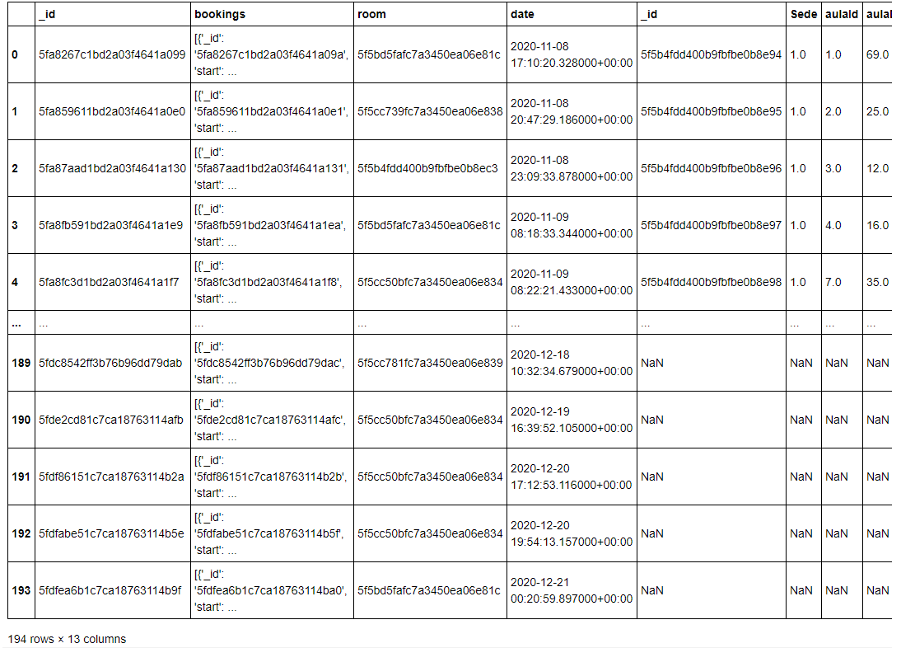
Load and Clean Data
result

Slide 5
Load and Clean Data
res = rs.merge(rooms, how='inner', left_on=['room'], right_on=['_id'])
# this creates an inner join similar to that of SQL, we get data from 2 tables based on a given common column(foreign key)
res.to_csv('room_booking.csv')

Slide 6
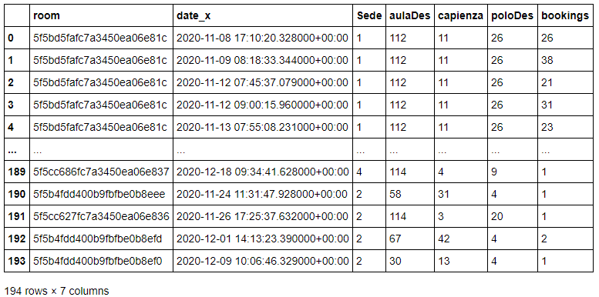
Load and Clean Data
data=pd.read_csv('room_booking.csv')
data=data.drop(['Unnamed: 0','aulaId'],axis=1)
df=spark.createDataFrame(data)
for i in df.columns:
print(i+":",df[df[i].isNull()].count())
room: 0
date_x: 0
Sede: 0
aulaDes: 0
capienza: 0
poloDes: 0
bookings: 0

Slide 7
Data Insights
df.printSchema()
root
|-- room: string (nullable = true)
|-- date_x: string (nullable = true)
|-- Sede: long (nullable = true)
|-- aulaDes: long (nullable = true)
|-- capienza: long (nullable = true)
|-- poloDes: long (nullable = true)
|-- bookings: long (nullable = true)

Slide 8
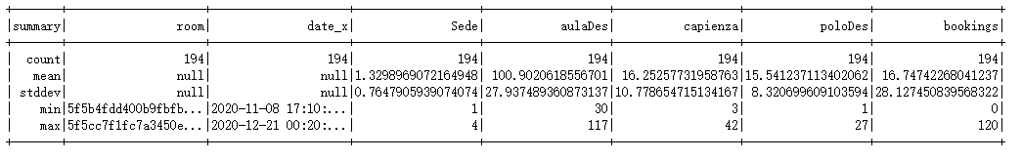
Data Insights
df.describe().show()

Slide 9
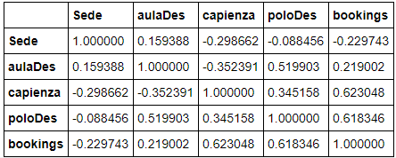
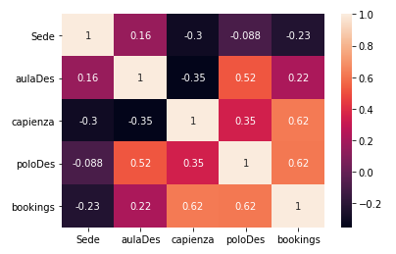
Correlation Matrix
data.corr()
sns.heatmap(data.corr(),annot=True)

Slide 10
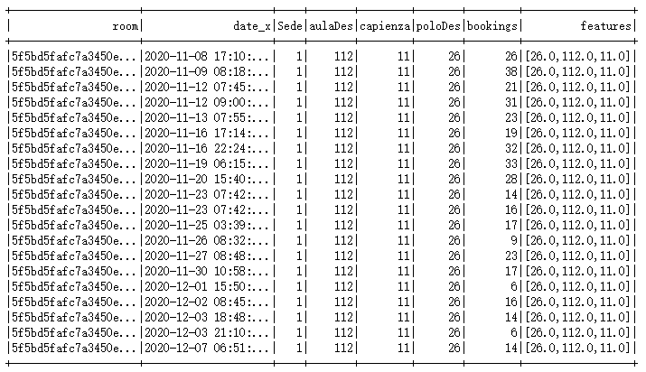
Feature Selection
from pyspark.ml.feature import VectorAssembler
assembler= VectorAssembler(inputCols=['poloDes','aulaDes','capienza'],outputCol='features')
output_data= assembler.transform(df)
output_data.show()

Slide 11
Linear Regression
Y = A · x + b
A = [a1,a2,…,an] depends on the dimensions
x = [x1,x2,…,xn] depends on the dimensions
Our dataset feature dimension is 3('poloDes','aulaDes','capienza’)
x = ['poloDes','aulaDes','capienza’]
Y = ['bookings’]
Y = a1 * x1 + a2 * x2 + a3 * x3 + b
The goal is training to obtain A and b

Slide 12
Achieved Results (Linear Regression)
Train
final_data = output_data.select('features','bookings')
train , test = final_data.randomSplit([0.7,0.3])
models = LinearRegression(featuresCol='features',labelCol='bookings')
model= models.fit(train)
Summary
print('coefficients:',model.coefficients) coefficients: [0.617857248242524,0.3873817029213937,1.8221422526175588]
print('intercept:',model.intercept) intercept: -60.71502307990856
summary=model.summary
print('RMSE',summary.rootMeanSquaredError) RMSE 18.556423459913947
print('R2 scrore:',summary.r2) R2 scrore: 0.6066008550382094
Evaluation
predictions = model.transform(test)
predictions.show(100)
evaluator= RegressionEvaluator(predictionCol='prediction',labelCol='bookings',metricName='r2')
print('test data r2 value:',evaluator.evaluate(predictions)) test data r2 value: 0.6704525136345016

Slide 13
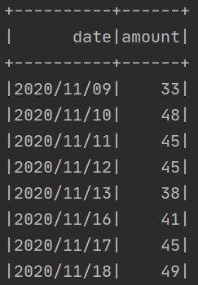
Select By Combination of aula,sede,polo
dataset = spark.read.csv('data_csv/presences.csv', header=True, inferSchema=True)
dataset = dataset.filter(dataset['aula'] == '1').filter(dataset['sede'] == '1').filter(dataset['polo'] == '1')
dataset = dataset.withColumn('id', F.monotonically_increasing_id())
dataset = dataset.select(F.date_format('date', 'yyyy/MM/dd').alias('date'))
dataset = dataset.groupBy(dataset.date).agg(F.count('date').alias('amount')).sort('date')
dataset.toPandas().to_csv('data_csv/presences2.csv')
dataset.show()
Time Series x = [x1, x2, …, xn]
xi = [year-month-day]
y = [v1, v2, …, v3]

Slide 14
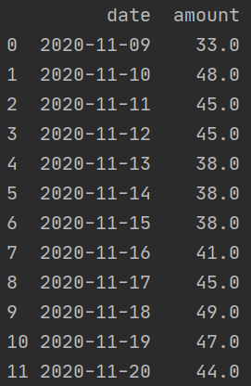
Imputation
df = pd.read_csv('data_csv/presences2.csv')
df['date'] = pd.to_datetime(df['date'])
grouper = pd.Grouper(key='date', freq='1D')
res = df.groupby(grouper).first().ffill().reset_index()
res = res.fillna(0).drop(columns=['Unnamed: 0'])
res.to_csv('data_csv/presences3.csv')
Time Series x = [x1, x2, …, xn]
xi = [year-month-day]
y = [v1, v2, …, v3]

Slide 15
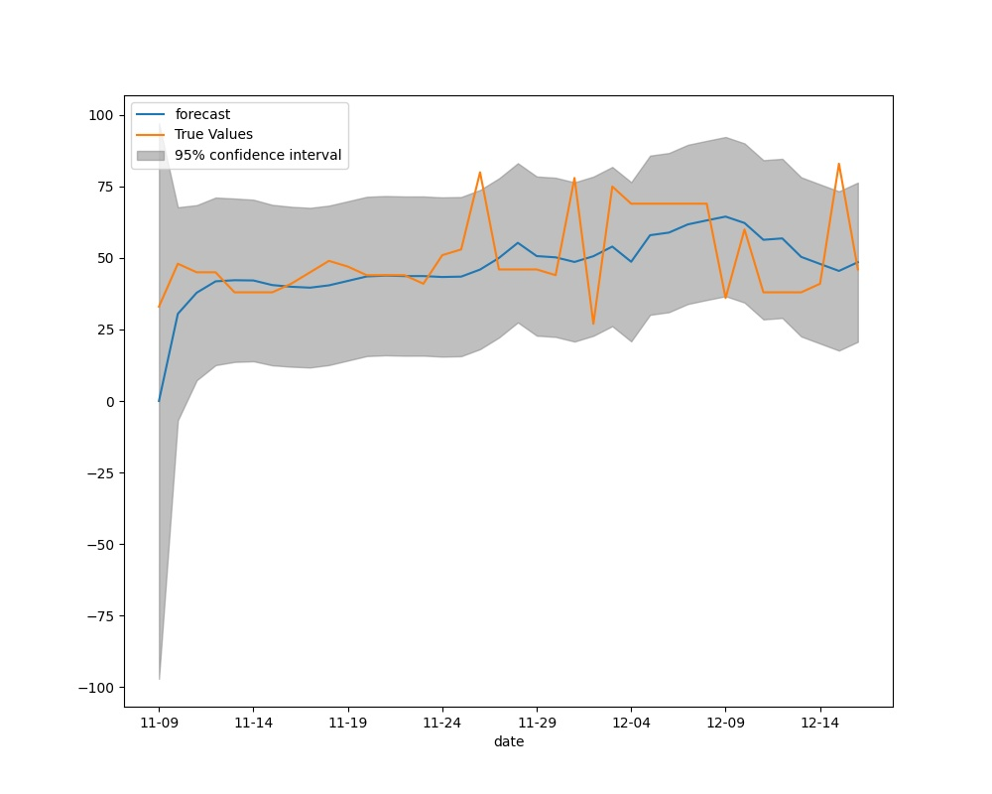
Achieved Results (Time Series)

Slide 16
Possible Future Improvement
Try more ML regression model such as Decision Tree, Random Forest, …
Use other different imputation methods, moreover try to use some interpolation method from numerical calculation.

